Slide 1



WellBot – Global Wellness Assistant
WELLBOT
Milestone 3 Progress
Role: Frontend Development

Slide 2




Dashboard Enhancements
Optimizing User Experience through Data Visualization
Total Users Display
Feedback Monitoring
Improved UI
Real-time tracking of the growing user base for better scalability insights and performance monitoring.
Integrated system to capture and display user sentiments directly on the dashboard for rapid response.
Refined navigation and layout for a more intuitive, responsive, and accessible user experience across devices.

Slide 3

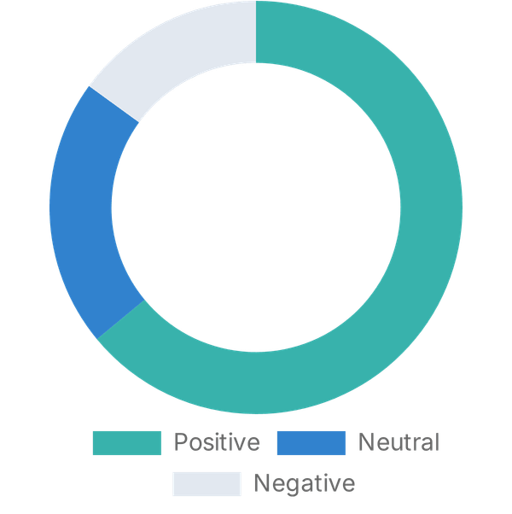
Feedback Analytics
Data-Driven Insights into User Satisfaction
1,240+
Sentiment Distribution
Total Feedback Collected
4.2 / 5.0
Average User Rating
64%
Positive Feedback Percentage

Slide 4







Stress Classification Feature
Questionnaire-Based Assessment for Personalized Care
Daily Stress Levels
Evaluating the frequency and intensity of perceived stress in daily activities.
Sleep Quality & Duration
Monitoring rest patterns and their impact on cognitive and physical recovery.
Energy & Vitality
Assessing overall physical energy levels and resistance to fatigue.
Anxiety & Emotional State
Identifying early signs of emotional distress and psychological tension.
External Pressure
Measuring the impact of work, social, and environmental demands.

Slide 5




Stress Level Categories
Proactive Wellness Management through Color-Coded Alerts
< 25%
25 – 50%
50 – 75%
75 – 100%
RED ALERT
ORANGE ALERT
OKAY STAGE
GREEN STAGE
Critical stage requiring immediate attention and intervention.
Warning stage indicating significant stress levels.
Stable condition with room for wellness optimization.
Optimal wellness and high resilience levels.

